Slide 1
WAS/WERE Past Simple Tense

Slide 2
WAS/WERE
POSITIVE & NEGATIVE FORM
I
He
She
It
We
You
They
was/wasn’t at school yesterday.
were/weren’t at the beach last week.

Slide 3
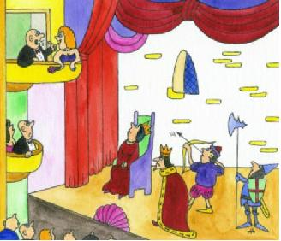
QUESTION FORM
I
He
She
It
We
You
They
Yes, she was.
No,she wasn’t.
Was
hungry?
at the theatre last weekend?
Were
Yes, we were.
No,we weren’t.

Slide 4
THERE WAS THERE WERE
There was an interesting film last night.
There were many students at the concert.
Using there was or there were depends on the subject of the sentence. If the subject is singular, use was. If it’s plural, use were.

Slide 5
I __________ at home yesterday.
were
wasn’t
weren’t
I __________ at school.
was
wasn’t
were
I __________ happy, because
was
wasn’t
were
My friends __________ at school.
was
were
weren’t

Slide 6
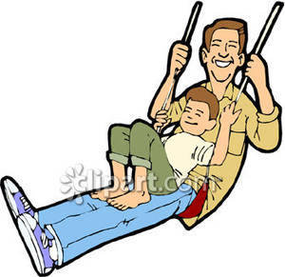
Tom __________ in the playground last week.
was
wasn’t
were
He __________ with his dad.
was
wasn’t
were
Tom’s mum __________ in the playground.
was
wasn’t
were
He __________ on the swing.
wasn’t
was
weren’t

Slide 7
Sally and Tom __________ in the ZOO last weekend.
was
is
were
There __________ elephants in the ZOO.
was
were
weren’t
They __________ huge.
was
are
weren’t
But the children _________ scared.
was
were
weren’t

Slide 8
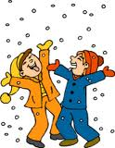
Yesterday it __________ snowy.
was
wasn’t
were
It __________ hot, but
was
wasn’t
were
the boys __________ sad.
were
weren’t
wasn’t
They __________ happy.
were
was
weren’t
The children __________ in the garden.
was
weren’t
were

Slide 9
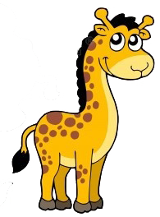
I was in the zoo yesterday.
I am in the museum now.

Slide 10
My friend is 6 years old now.
He was 5 years old last year.

Slide 11
The weather was rainy yesterday.
It is sunny today.

Slide 12
He was a student ten years ago.
He is a teacher now.

Slide 13
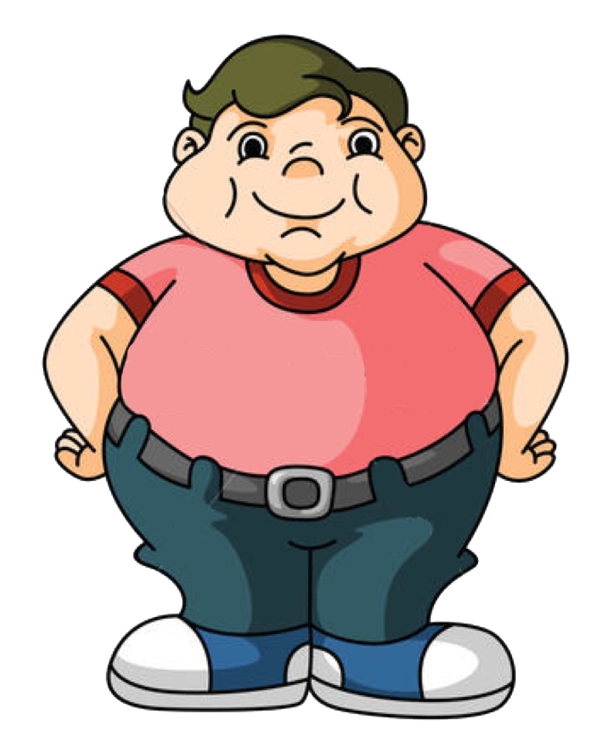
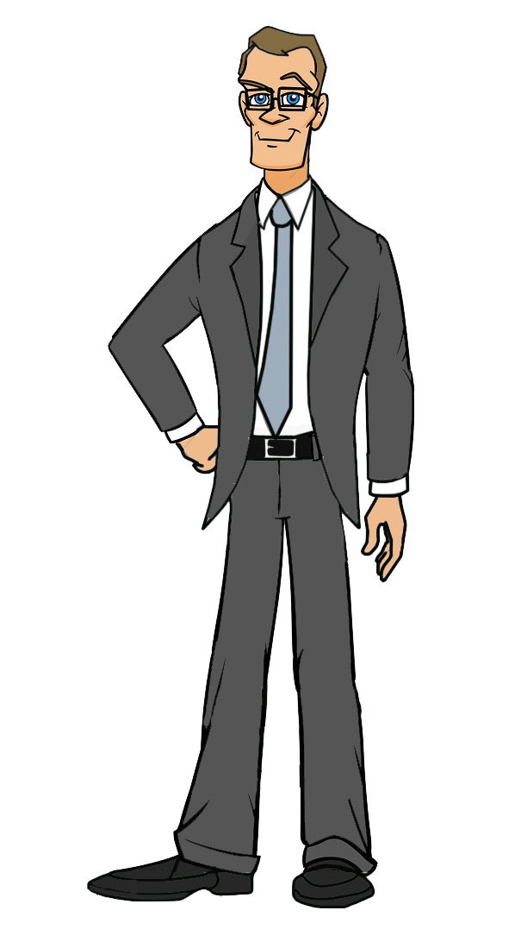
I was chubby when I was young.
I am slim now.

Slide 14
THANK YOU!

